Slide 1
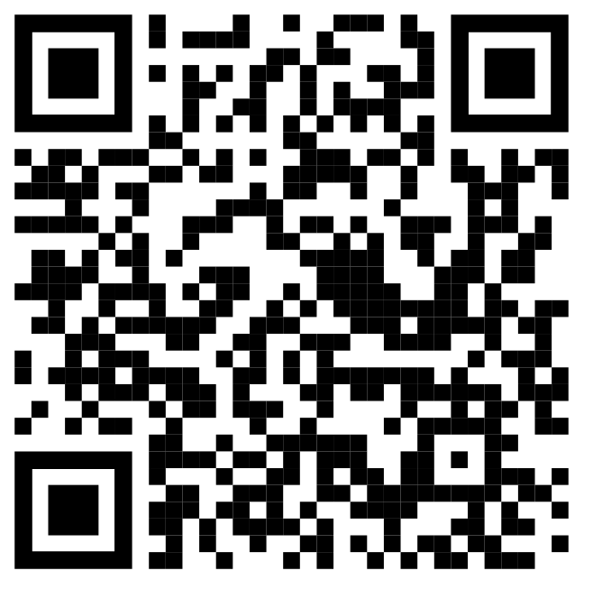
DAX as Dance
Barney Lawrence
@SQLBarney
github.com/BarneyLawrence
/Sessions-DAX-Through-Dance

Slide 2
Dance

Slide 3





About Me

Slide 4

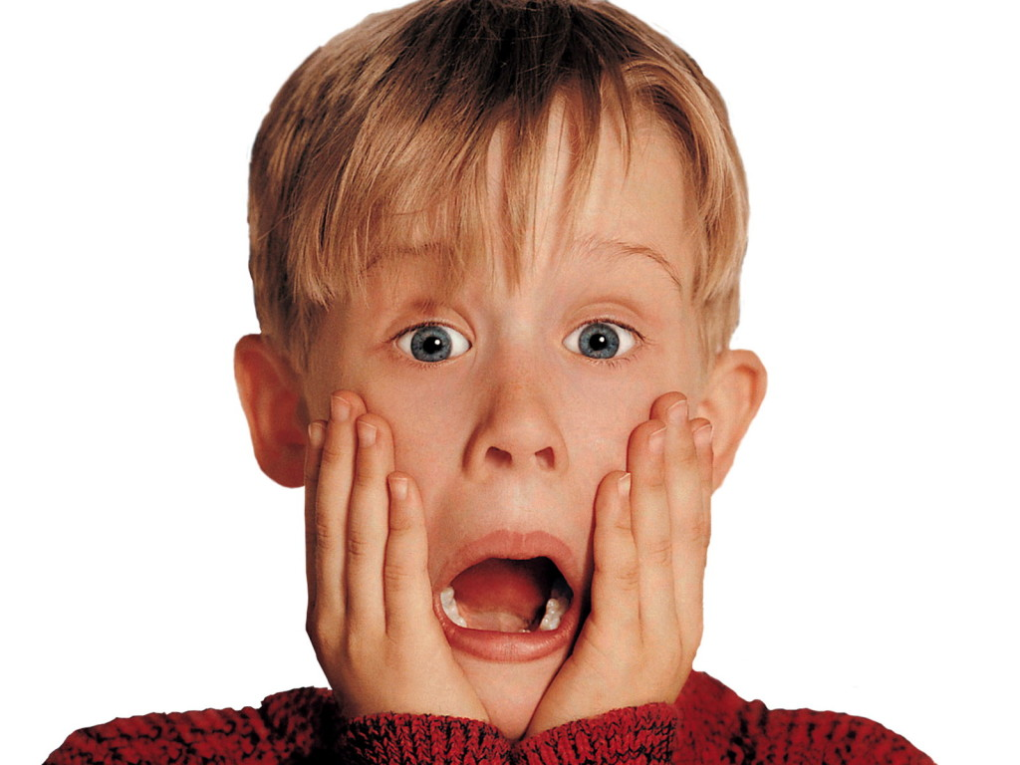
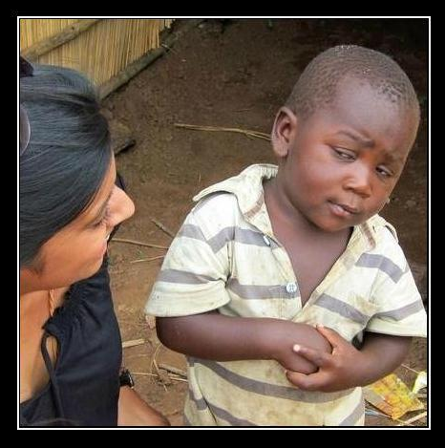
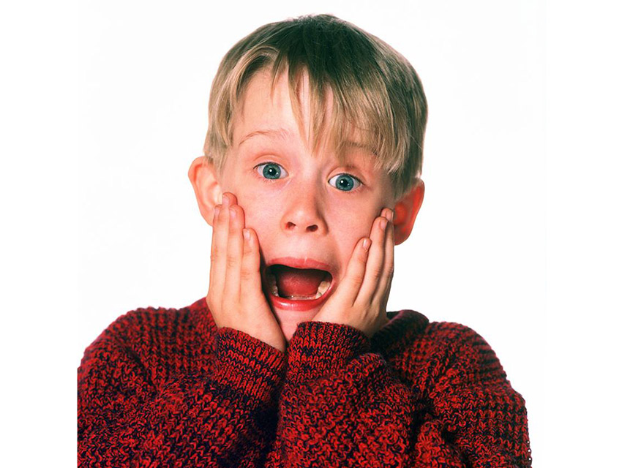
What?!
Notes:
Why an I doing this?

Slide 5
Key Points
Filter Context
Row Context
Calculate and Context Transition

Slide 6
A Measure
MySum = SUM(MyValues)

Slide 7
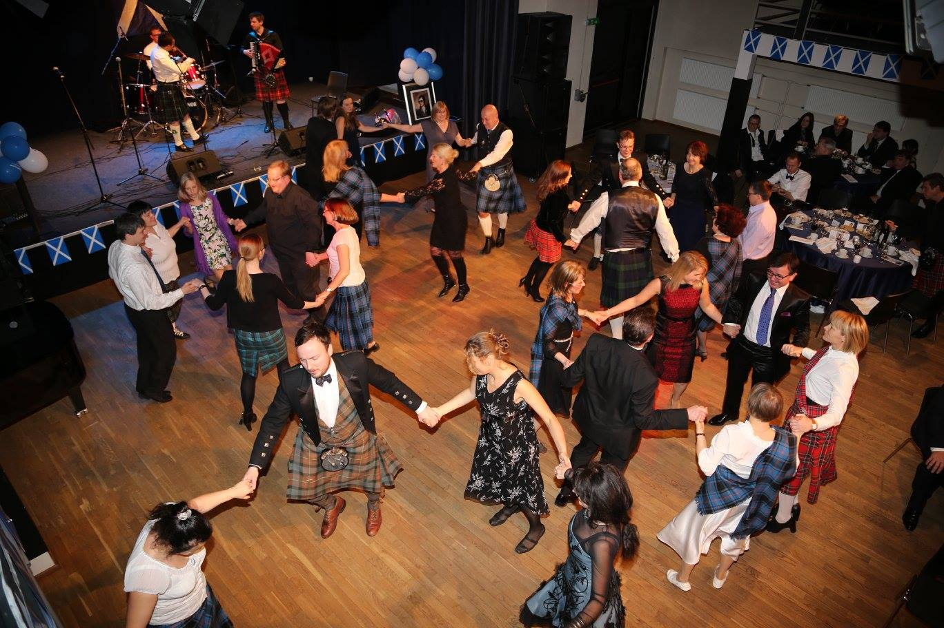
Filter Context

Slide 8
Example 1
Couple | Value 1 | Value 2
Couple 1 | 2 | 1
Couple 2 | 2 | 1
Couple 3 | 2 | 1
SUM(Value1 x Value2)
=Error

Slide 9
Example 1
Couple | Value 1 | Value 2
Couple 1 | 2 | 1
Couple 2 | 2 | 1
Couple 3 | 2 | 1
SUM(Value1) x SUM(Value2)
= (2 + 2 + 2)
x (1 + 1 + 1)
=18

Slide 10
Introducing SUMX
SUMX (Table, Expression)
SUMX(
Dancers,
Dancers[Value 1]*Dancers[Value 2]
)

Slide 11
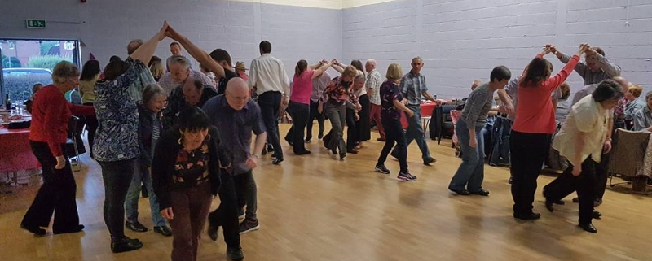
Row Context

Slide 12


Dance 1

Slide 13
Dance 1
= (2 x 1)

Slide 14
Dance 1
= (2 x 1)
+ (2 x 1)
+ (2 x 1)
=6

Slide 15
Example 2
Measure 2 = SUMX(
Dancers,
SUM(Dancers[Value 1])
*SUM(Dancers[Value 2])
)

Slide 16
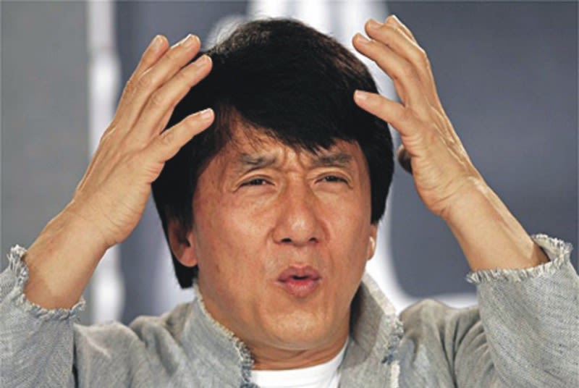
Guess The Answer
(2x1 + 2x1 + 2x1)
(2+2+2) x (1+1+1)
54
6
18

Slide 17


An Explanation

Slide 18
(2+2+2) x (1+1+1)
Row 1
=18
=0
Value 1 - Value 2

Slide 19
(2+2+2) x (1+1+1)
+(2+2+2) x (1+1+1)
Row 1
Row 2
=36
=18
Value 1 - Value 2

Slide 20
(2+2+2) x (1+1+1)
+(2+2+2) x (1+1+1)
+(2+2+2) x (1+1+1)
Row 1
Row 2
=54
=36
Row 3
Value 1 - Value 2

Slide 21
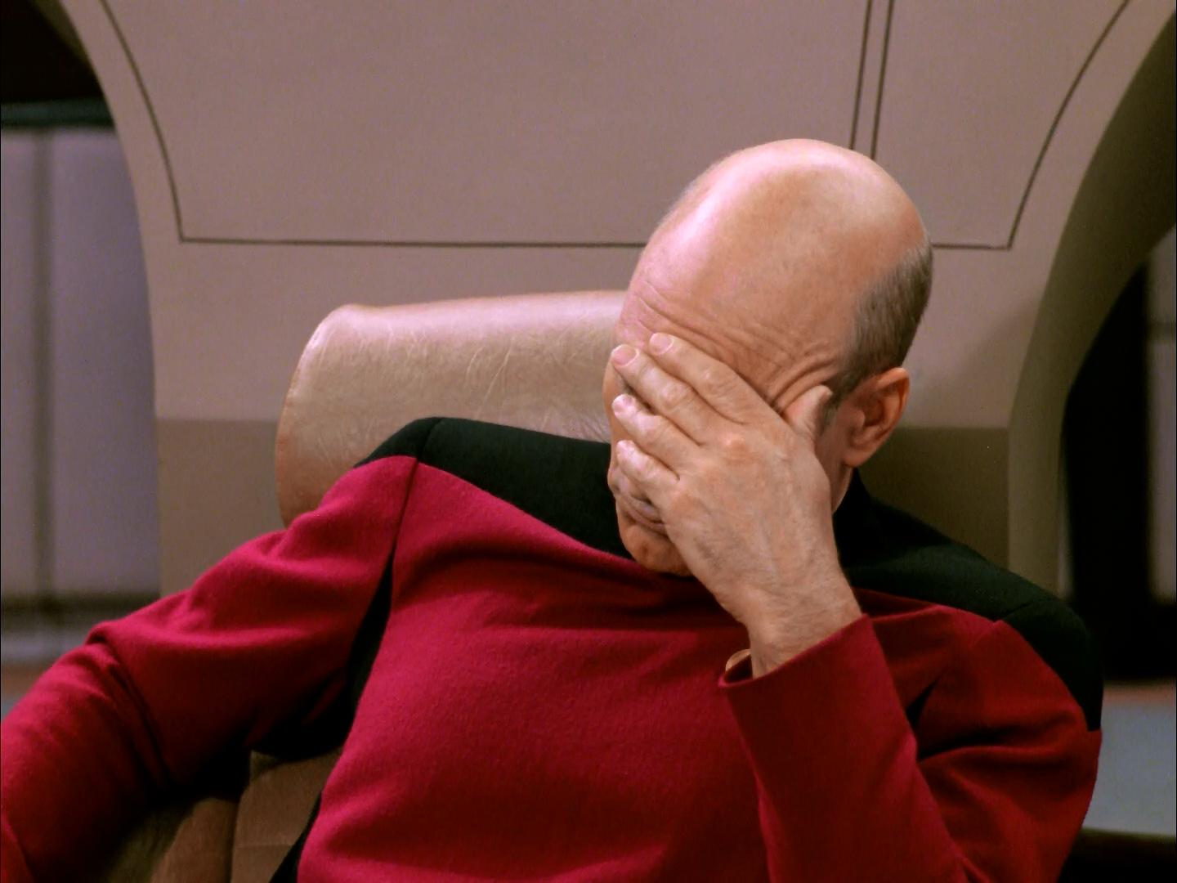

Slide 22
Example 2 - Fixed
Measure 2 = SUMX(
Dancers,
CALCULATE(
SUM(Dancers[Value 1])
*SUM(Dancers[Value 2])
)
)
Measure 2 = SUMX(
Dancers,
SUM(Dancers[Value 1])
*SUM(Dancers[Value 2])
)

Slide 23
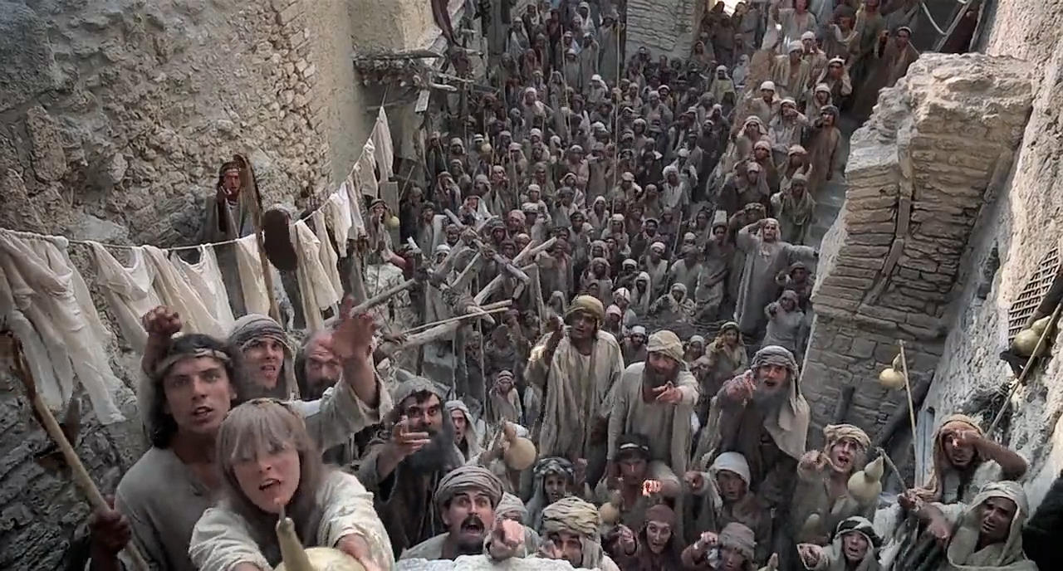
We’re all different!
I’m Not!

Slide 24
Example 2 – Part 2
Couple | Value 1 | Value 2
Olivia | 2 | 1
Olivia | 2 | 1
Amelia | 2 | 1

Slide 25
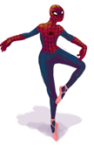
(2+2) x (1+1)
Value 1 - Value 2

Slide 26

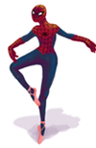

(2+2) x (1+1)
+(2) x (1)
=8
Value 1 - Value 2

Slide 27
(2+2) x (1+1)
+(2) x (1)
+(2+2) x (1+1)
=10
=18
Value 1 - Value 2

Slide 28
Key Points
Filter Context
Row Context
Calculate and Context Transition

Slide 29
DAX as Dance
Barney Lawrence
@SQLBarney
github.com/BarneyLawrence
/Sessions-DAX-Through-Dance

